Slide 1
Studio Project 1
Lim Ngian Xin Terry
Yin Shuyu
Chin Hao Ming
Wayne Aw

Slide 2
Contents
Storyline
Game Concept
Game Mechanics
Screenshots
Task Allocation

Slide 3
Storyline
The game is set in the Egyptian Era where a mummy, who is the true king of ancient Egypt, has
been revived by the power of the Egyptian gods. However, the mummy woke up to realise that
he’s been trapped inside the pyramid by the fake pharaoh as it is the fake pharaoh that murdered
him and used ancient magic to seal him as a mummy and appear similar to the true pharaoh.
Many obstacles and enemies await the mummy as he tries his hardest to escape the puzzling
levels of the pyramid to expose the devious acts of the fake pharaoh and to regain his throne and
position as the true ruler of Egypt.

Slide 4
Game Concept
2D Platformer Puzzle / Maze game.
Goal is to get out of the maze to the next level.
As levels progress, there are traps / monsters to block the player.
Players can also push / pull boxes to help clear obstacles.
There are also buttons and keys to open doors.
Teleporters in levels to confuse the players.

Slide 5
Game Mechanics
Able to push / pull boxes.
Teleporters in levels.
Stepping on buttons.
Gravity.
Players respawn upon touching lava / monsters / traps.
Destroy lava using boxes.
Moving the character.

Slide 6
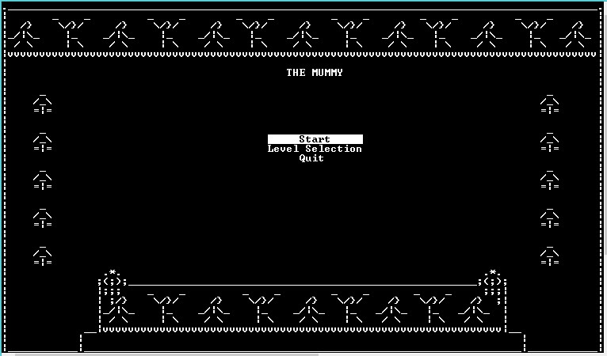
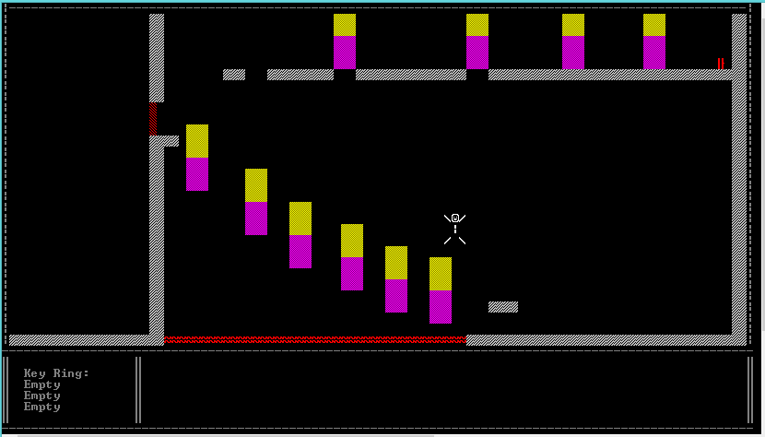
Screenshots

Slide 7
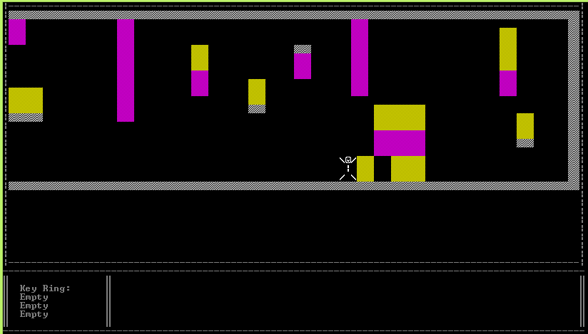
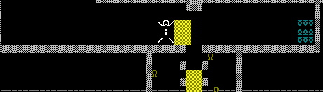
Task Allocation
Terry – Side-Scrolling Camera, Collisions, Boxes Interaction, Gravity, Character Movement

Slide 8
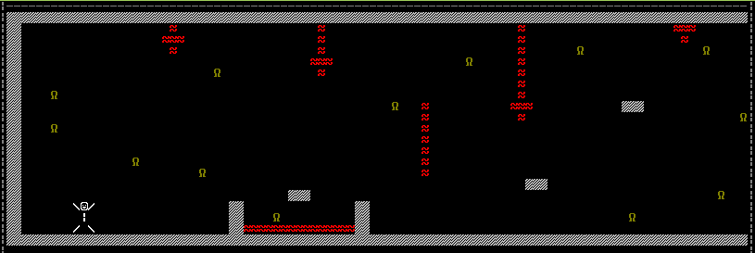
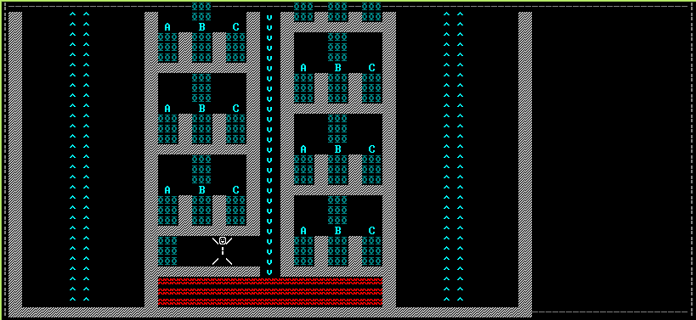
Task Allocation
Shuyu – Teleporters, Buttons, Monsters, Lava, Falling Rocks

Slide 9
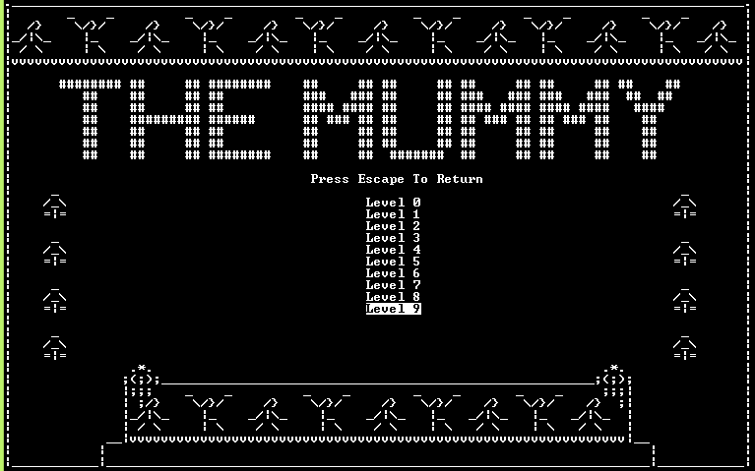
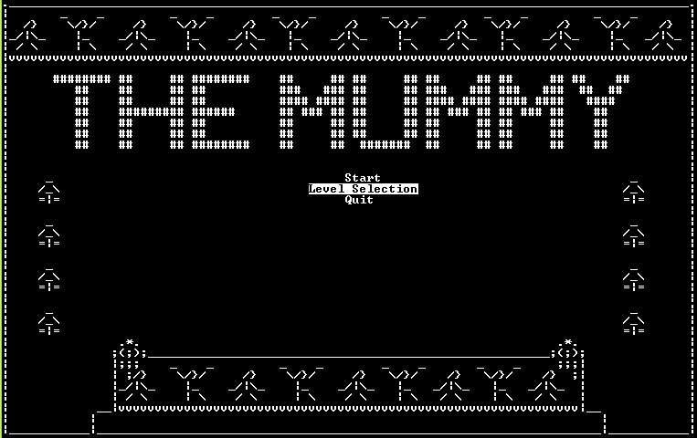
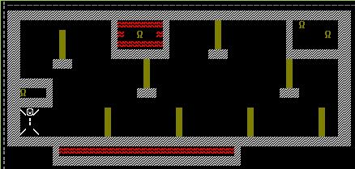
Task Allocation
Hao Ming – Main Menu, Pause Menu, Sounds, Level Selection, Portals to Next Level.

Slide 10
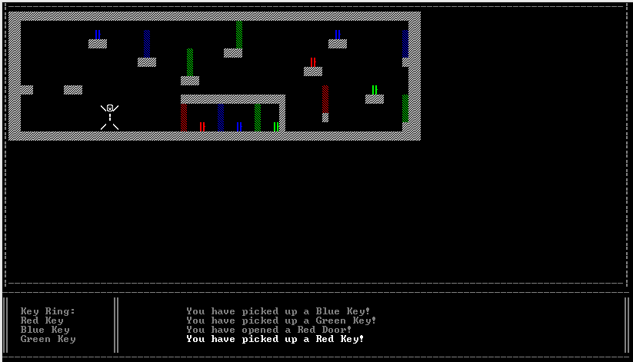
Task Allocation
Wayne – Keys, Doors, Inventory, Print Messages, Sounds.

Slide 11
Reflections
Terry:
I have learnt the importance of using version control to allow us to simultaneously work on the same project together. I also feel that in the future, we should dedicate more time to planning out exactly what we want to do and how we want to do a certain function before we code so that we will not be limited by mistakes we made very early on in the development, and have to spend even more time correcting our earlier code. It is also very important to plan roughly how much time is needed for each task and spread out the tasks evenly between members so that the workload is spread evenly.

Slide 12
Reflections
Hao Ming:
Throughout the whole of this studio project, I felt that there were quite a lot of things that I learnt from my teammates and some that I eventually learnt subsequently. I also learnt that teamwork plays quite an important role during this studio project as without my teammates, I wouldn't not what to do when I’m stuck. So henceforth, I think that studio project are essential in our course.

Slide 13
Reflections
Shuyu:
Through this studio project, I feel that there are still many things I need to learn. It is not enough to only learn in the labs, but also to engage in additional self study in order to improve myself. I also found out that there are many people in our course who are very good at coding. I need to catch up to others in terms of my skills.

Slide 14
Reflections
Wayne:
From this studio project , I realised the importance of the essence of teamwork. Individually, each of us are assigned to different tasks which we will merge all of them as one to become a complete project and even though we went through ups and downs (Being clueless on how to do things and losing codes) during the studio project , we managed to pulled it through and complete the game and though I feel like I did not do sufficiently enough for the team , it was still a meaningful experience nonetheless. Thanks Terry, our team leader, for inviting me to join their team and to Hao Ming and Shu Yu as well. It was a pleasant three weeks working with you all.

